Slide 1
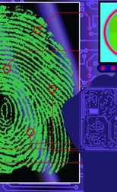
Timeline of Forensic Science
<insert name>

Slide 2
Edmond Locard
1877-1966
French scientist that founded the world’s first crime lab in Lyon France in 1910. Locard advanced the forensic science disciplines of questioned document examination, poroscopy as a method of fingerprint identification, and most notably trace evidence analysis. Locard developed the concept that “every contact leaves a trace” now referred to as the Locard exchange principal
Notes:
** The first entry has been completed to provide you an example.
Edmond Locard was able to demonstrate to law enforcement authorities that the scientific analysis of trace evidence such as dust particles could link suspects to victims and crime scenes. Locard’s tireless research and successful analysis, identification and comparison of dust traces led to the founding of many other forensic science labs throughout Europe and North America.
Minimum of five influential court cases that have affected how forensic science is used in the criminal justice system.
One example: Frye V. United States. This case focused on the scientific foundation for the methodology of the lie detector machine. The Supreme Court took developed the general acceptability rule based on general acceptance of a methodology by the relevant scientific community.

Slide 3
Notes:
Dr. Edmond Locard was able to demonstrate to the police of the value of the scientific examination of trace evidence including dust

